Slide 1
Arduino Data types
The data types are used to identify the types of data and the associated functions for handling the data. It is used for declaring functions and variables, which determines the bit pattern and the storage space.
The data types that we will use in the Arduino are listed below:
void Data Type
int Data Type
Char Data Type
Float Data Type
Double Data Type
Unsigned int Data Type
short Data Type
long Data Type
Unsigned long Data Type
byte data type
word data type

Slide 2
void Data Type
The void data type specifies the empty set of values and only used to declare the functions. It is
used as the return type for the functions that do not return any value. Let's understand with an example in Arduino.
Consider the below code.
int a = 3;
void setup( ) 3. {
4. . //
5. }
6. void loop ( )
{
.
.
}

Slide 3
Int Data Type
The integer data types are the whole numbers like 5, -6, 10, -123, etc. They do not have any
fractional part. The integer data types are represented by int. It is considered as the primary data type to store the numbers. The size of int is 2 bytes (16 bits).
Minimal range: -32768 to 32767 or - (2^ 15) to ((2 ^ 15) - 1)
In the ATmega and Arduino UNO boards, the int data types store the value of 2 bytes.
On the boards like Arduino Zero and MKR1000 (SAMD boards), and Arduino Due, the int data type stores the value of 4 bytes or 32 bits. The Minimal range in such case would be - (2^ 31) to ((2 ^ 31) - 1) or -2,147,483,648 to 2,147,483,647.
The negative numbers are stored in the form of 2's complement, where the sign bit or the highest bit is flagged as the negative number.
The syntax is used as:
1. int var = val; where,
var= variable
value = the value assigned to the variable

Slide 4
For example,
int a;
int b = 3;
Any variable or identifier becomes an integer variable and can hold only integer values. Let's understand with an example in Arduino.
Consider the below code.
int Sum = 0;
void setup( )
{
4. Serial.begin(9600);
}
void loop ( )
{
Sum++; // on every loop, it adds 1 to the Sum int
Serial.println ( Sum); // it prints the current state of the Sum variable
delay(1500); // delay of 1.5 seconds
}

Slide 5
Char Data Type
The char datatype can store any number of character set. An identifier declared as the char
becomes a character variable. The literals are written inside a single quote. The char type is often
said to be an integer type. It is because, symbols, letters, etc., are represented in memory by associated number codes and that are only integers.
The size of character data type is minimum of 8 bits. We can use the byte data type for an unsigned char data type of 8 bits or 1 byte.
For example, character ' A ' has the ASCII value of 65.
If we specify, ' A ' + 2, it will have the ASCII value of 67. The syntax is:
1. char var = val;
where,
var= variable
val = The value assigned to the variable.

Slide 6
Let's understand with an example. Consider the below code.
char myvariable = ' B ';
char myvariable = 66 ; // both the value are equivalent

Slide 7
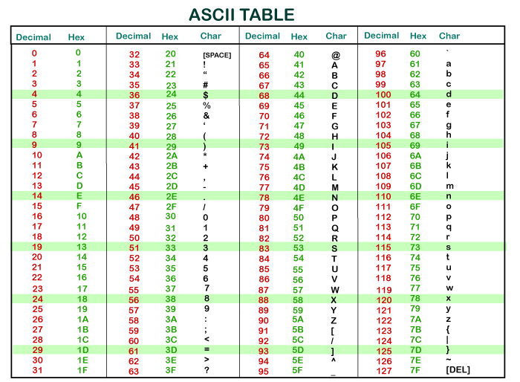
The ASCII table is shown below:
val = The value assigned to the variable

Slide 8
Float Data Type
A number having the fractional part and a decimal part is considered as a floating-point number.
For example, 4.567 is a floating-point number. The number 13 is an integer, while 13.0 is a floating-point number. Due to their greater resolution, fractional numbers are used to approximate the contiguous and analog values.
Floating point numbers can also be written in the exponent form. The numbers can be as large as
3.4028235E+38 and as small as -3.4028235E+38. The size of float data types is 4 bytes or 32 bits.
The syntax is:
1. float var = val; where,
var= variable
val = The value assigned to the variable

Slide 9
Let's understand with an example.
int a ;
int b ;
float c ;
void setup ( ) 5. {
6. Serial.begin (9600); 7. }
8. void loop ( ) 9. {
10. a = 3 ;
b = a/2 ; // b is an integer. It cannot hold fractions. The output will be 1.
c = (float) a / 2.0 ; // c now contains 1.5.
// Here, we have to use 2.0 instead of 2.
14. }

Slide 10
Note: We need to add a decimal point to a number. Otherwise, it will be considered as an integer. For example, 14.0 is considered as a float number, while 14 is an integer.
The floating-point numbers can also be converted to integers. For example,
float a = 3.6 ;
int b = a + 0.6 ; // output = 4
Double Data Type
The double data type is also used for handling the decimal or floating-point numbers. It occupies
twice as much memory as float. It stores floating point numbers with larger precision and range. It stands for double precision floating point numbers.
It occupies 4 bytes in ATmega and UNO boards, while 8 bytes on Arduino Due. The syntax is:
1. double var = val;
where,
var= variable
val = The value assigned to the variable

Slide 11
Unsigned int Data Type
The unsigned int stores the value upto 2 bytes or 16 bits. It stores only positive values. The range
of unsigned int data type is from 0 to 65,535 or 0 to ((2 ^ 16) - 1). Arduino Due stores the unsigned data value of 4 bytes or 32-bits.
The difference between Unsigned and signed data type is the sign bit. The int type in Arduino is the signed int. In a 16-bit number, 15 bits are interpreted with the 2's complement, while the high bit is interpreted as the positive or negative number. If the high bit is '1', it is considered as a negative number.
The syntax is:
1. unsigned int var = val; where,
var= variable
val = The value assigned to the variable For example,
1. unsigned int pinofLED = 8;

Slide 12
short Data Type
The short is an integer data type that stores two bytes or 16-bit of data.
The range of short data types is from -32768 to 32767 or - (2^ 15) to ((2 ^ 15) - 1). The ARM and ATmega based Arduino's usually stores the data value of 2 bytes.
The syntax is:
1. short var = val; where,
var= variable
val = the value assigned to the variable
For example,
short pinofLED = 8 ;

Slide 13
long Data Type
The long data types are considered as the extended size variables, which store 4 bytes (32 -bits).
The size ranges from -2,147,483,648 to 2,147,483,647.
While using integer numbers, at least one of the numbers should be followed by L, which forces the number to be a long data type.
The syntax is:
1. long var = val; where,
var= variable
val = The value assigned to the variable For example,
1. long speed = 186000L;
byte Data Type
1 byte = 8 bits.
It is considered as an unsigned number, which stores values from 0 to 255.
The syntax is:

Slide 14
Unsigned long Data Type
The unsigned long data types are also considered as the extended size variables, which store 4
bytes (32 -bits). It does not store negative numbers like other unsigned data types, which makes their size ranges from 0 to 4,294,967,295 or (2^32 - 1).
The syntax is:
1. unsigned long var = val; where,
var= variable
val = The value assigned to the variable For example
1. unsigned long currenTtime;

Slide 15
byte Data Type
1 byte = 8 bits.
It is considered as an unsigned number, which stores values from 0 to 255.
The syntax is:
1. byte var = val; where,
var= variable
value = the value assigned to the variable
For example,
1. byte c = 20;

Slide 16
word Data Type
It is considered as an unsigned number of 16 bits or 2 bytes, which stores values from 0 to 65535.
The syntax is:
1. word var = val; where,
var= variable
val = The value assigned to the variable
For example,
word c = 2000;

